Slide 1
January 2025

Slide 2
ALL-Industry Effort for ALL PLMA Members and Their Retailer Partners
Bringing together all segments of the industry to promote All Store Brands items across All categories to consumers
In-store, Online, Nationally through Traditional, Digital and Social Media
What is
Store Brands Month?
Goals
Increase the Sales and Consumption of Private Brands
Enhance the Overall Positive Sentiment of Products
Continuing the Value. Quality. Innovation. Story

Slide 3
The Purpose of Store Brands Month
Matching large portfolio multi-category brand owners with thematic merchandising events
Create awareness and value described as: Great Quality at Everyday Better Prices
NOT about price or discounts on everyday prices

Slide 4
Guidelines
for Retailers

Slide 5
Keep all colors and proportions of the logo as is
Display the logo on a white or light color background
Try not to reduce it smaller than 3 inch wide (unless used as tag in circular)
Use it in a headline or as a sign-off in your normal advertising
Questions? Please reach out to storebrandsmonth@plma.com
Here are some of the best ways to use your
Store Brands Month Logo

Slide 6
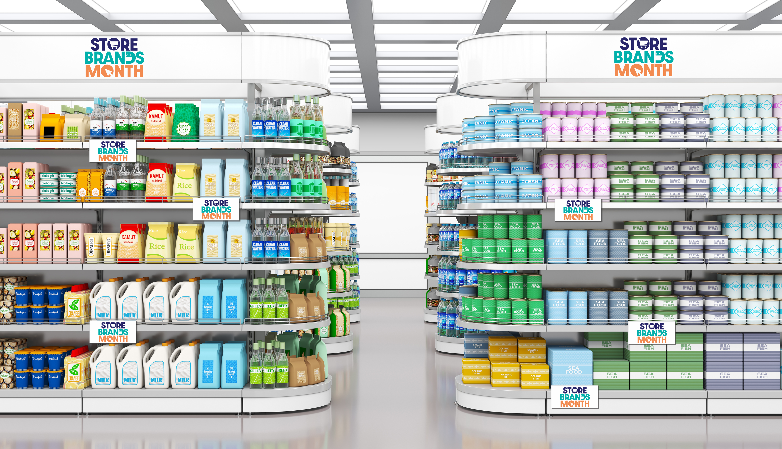
Use the Store Brands Month Logo on Shelf as Your Point of Sale to Highlight:
Your assortment of private label SKUs across multiple categories
The premium tier SKUs that shows your commitment to quality
There are many areas of your omni-channel universe where private brands are a differentiator

Slide 7
Use Store Brands Month as a way to educate your shoppers on the impact of your exclusive brands have in your market and in the industry
Did you know that retail-owned brands account for 1 out of every 5 products sold in the United States?
Your store brand stands
for quality everyday.

Slide 8
The Store Brands Month toolkit has the tools and the ideas to help you create effective and profitable promotion
Work with your industry partners
to plan for the January events
Use your Marketing and Social Media Outlets to connect with your customers about the benefits of Private Brands

Slide 9
How You Benefit By Participating

Slide 10
Ways Your Company Can Participate in Store Brands Month
Work with industry partners (manufacturers, distributors, brokers/sales agents) to create profitable in-store promotions during January
Utilize Store Brands Month content on your social platforms to connect with customers about the benefits of the private brands
Store Brands Month has the tools and ideas to help you create an effective and profitable promotion

Slide 11
Ideas for a Successful Promotion

Slide 12
Store Brands
Month
Let’s
ACE It!
Create Awareness Within the Industry
Encourage Collaboration Between Supplier and Retailer
Support Engagement with Consumers

Slide 13
Awareness, Collaboration, Engagement
Cultivate Beneficial Partnerships
Retailers/Wholesalers should connect with manufacturer, distributors, brokers/sales agents to advise of planned promotions
Be a Social Media Influencer
Providing information about the benefits of store brands positions your brand as an authority and influencer
Store Brands Month has sample social posts and messaging, infographics, videos that you can include in your e-newsletters, social media and on your website. Look for the Store Brands Month Retailer Toolkit on plma.com
Promote Consumer Giveaways
Promoting consumer giveaways creates social engagement and excitement among your audience

Slide 14
Awareness, Collaboration, Engagement
Utilize and Leverage the Store Brands Month Brand
Provide a consistent look in your advertising for easy consumer recognition using the Store Brands Month logo
Visit Store Brands Month Toolkit Store Brands Month Retailer Toolkit | PLMA to download the logo for your website, flyers, circulars, and other communications
Share Store Brands Month Content and Posts on Your Social Media Platforms
Easily take your promotion to the next level by using the Store Brands Month social media posts found in the Store Brands Month Toolkit
Host In-Store Events and Demos
In-store events like contests and giveaways engage consumers at the point of purchase. Demos are proven to increase trial and sales. Plan your special January event and draw more shopper attention to the aisle

Slide 15
Remember:
Forecast and Communicate Your Plans by Category/Item to Your Suppliers

Slide 16
Consumer Outreach During January

Slide 17
Increased post-holiday cooking exhaustion – one pot meals
How to make a clean sweep into the new year – closets, pantry, home office organization
Healthy meals that hit specific health trends that would appeal to consumers eating healthier in the new year
“New Year - New You” with health and wellness products
Grammy Awards Jan 31, 2025: Cocktails/mocktails and party supplies
Sample
Promotional
Ideas Throughout the Store

Slide 18
Meal planning for $X.XX per day
How to stock a cold & flu pantry
Create a winter preparedness kit for your car
What’s in your medicine cabinet, fridge or pantry?
Don’t Forget
Instagram
Facebook
TikTok

Slide 19
Promote your company’s efforts to other industry executives
Comment/like/repost to gain greater exposure for Store Brands Month
Don’t Forget
LinkedIn
X

Slide 20
Increased Brand Awareness of Your Brands
Trial of New Product(s)
Increased Penetration of Your Brands
What is Success?

Slide 21
Awareness, Collaboration, Engagement
You
ACED
It!

